Slide 1
Inner Classes
2

Slide 2
Agenda
Introduction.
2. Normal or Regular inner classes o Accessing inner class code from static area of outer class
o Accessing inner class code from instance area of outer class
o Accessing inner class code from outside of outer class
o The applicable modifiers for outer & inner classes
o Nesting of Inner classes
3. Method Local inner classes
4. Anonymous inner classes
o Anonymous inner class that extends a class
o Anonymous Inner Class that implements an interface
o Anonymous Inner Class that define inside method arguments
o Difference between general class and anonymous inner classes
o Explain the application areas of anonymous inner classes ?
5. Static nested classes o Compression between normal or regular class and static nested class ?
6. Various possible combinations of nested class & interfaces
o class inside a class
o interface inside a class o interface inside a interface
o class inside a interface
7. Conclusions
2

Slide 3
Introduction
2

Slide 4
• Sometimes we can declare a class inside another class such type of classes are called inner classes.
Diagram:
• Sun people introduced inner classes in 1.1 version as part of "EventHandling" to resolve GUI bugs.
• But because of powerful features and benefits of inner classes slowly the programmers starts using in regular coding also.
• Without existing one type of object if there is no chance of existing another type of object then we should go for inner classes.
Example:
Without existing University object there is no chance of existing Department object hence we have to define Department class inside University class.
2

Slide 5
Example1:
Example 2:
Without existing Bank object there is no chance of existing Account object hence we have to define Account class inside Bank class.
Example:
Example 3:
Without existing Map object there is no chance of existing Entry object hence Entry interface is define inside Map interface. Map is a collection of key-value pairs, each key-value pair is called an Entry.
Example:
Diagram:
Note : Without existing Outer class Object there is no chance of existing Inner class Object.
3

Slide 6
Note: The relationship between outer class and inner class is not IS-A relationship and it is Has-A relationship.
Based on the purpose and position of declaration all inner classes are divided into 4 types. They are:
1. Normal or Regular inner classes
2. Method Local inner classes
3. Anonymous inner classes
4. Static nested classes.
3

Slide 7
1. Normal (or) Regular inner class:

Slide 8
If we are declaring any named class inside another class directly without static modifier such type of inner classes are called normal or regular inner classes.
Example:
class Outer
{
class Inner
{
}
}
Output:
Example:
class Outer
{
class Inner
{
}
public static void main(String[] args)
{ System.out.println("outer class main method");
}
}
4

Slide 9
Output:
• Inside inner class we can't declare static members. Hence it is not possible to declare main() method and we can't invoke inner class directly from the command prompt.
Example:
class Outer
{
class Inner
{ public static void main(String[] args)
{
System.out.println("inner class main method");
}
}
}
Output:
E:\scjp>javac Outer.java Outer.java:5: inner classes cannot have static declarations public static void main(String[] args)
5

Slide 10
Accessing inner class code from instance area of outer class:
Example:
class Outer
{
class Inner
{
public void methodOne()
{
System.out.println("inner class method");
}
}
public void methodTwo()
{
Inner i=new Inner();
i.methodOne();
}
public static void main(String[] args)
{
Outer o=new Outer();
o.methodTwo();
}
}
5

Slide 11
Output:
E:\scjp>javac Outer.java
E:\scjp>java Outer
Inner class method
Accessing inner class code from outside of outer class:
Example:
class Outer
{
class Inner
{
public void methodOne()
{
System.out.println("inner class method");
}
}
}
class Test
{
public static void main(String[] args)
{
new Outer().new Inner().methodOne();
}
}
6

Slide 12
Output:
Inner class method
• From inner class we can access all members of outer class (both static and nonstatic, private and non private methods and variables) directly.
Example:
class Outer
{
int x=10;
static int y=20;
class Inner{
public void methodOne()
{
System.out.println(x);//10
System.out.println(y);//20
}
}
public static void main(String[] args)
7

Slide 13
{
new Outer().new Inner().methodOne();
}
}
• Within the inner class "this" always refers current inner class object. To refer current outer class object we have to use "outer class name.this".
Example:
class Outer
{
int x=10;
class Inner
{
int x=100;
public void methodOne()
{
int x=1000;
System.out.println(x);//1000
System.out.println(this.x);//100
System.out.println(Outer.this.x);//10
}

Slide 14
public static void main(String[] args)
{
new Outer().new Inner().methodOne();
}
}
The applicable modifiers for outer classes are:
1. public
2. default
3. final
4. abstract
5. strictfp
But for the inner classes in addition to this the following modifiers also allowed.
. public default final abstract strictfp static abstract and final
Nesting of Inner classes :
We can declare an inner class inside another inner class
8

Slide 15
Method local inner classes:
8

Slide 16
• Sometimes we can declare a class inside a method such type of inner classes are called method local inner classes.
• The main objective of method local inner class is to define method specific repeatedly required functionality.
• Method Local inner classes are best suitable to meet nested method requirement.
• We can access method local inner class only within the method where we declared it. That is from outside of the method we can't access. As the scope of method local inner classes is very less, this type of inner classes are most rarely used type of inner classes.
Example:
class Test
{
public void methodOne()
{
class Inner
{
public void sum(int i,int j)
{
System.out.println("The sum:"+(i+j));
}
8

Slide 17
}
Inner i=new Inner();
i.sum(10,20);
;;;;;;;;;;;;;
i.sum(100,200);
;;;;;;;;;;;;;;;
i.sum(1000,2000);
;;;;;;;;;;;;;;;;;
}
public static void main(String[] args)
{
new Test().methodOne();
}
}
Output:
The sum: 30
The sum: 300
The sum: 3000
9

Slide 18
• If we are declaring inner class inside instance method then we can access both static and non static members of outer class directly.
• But if we are declaring inner class inside static method then we can access only static members of outer class directly and we can't access instance members directly.
Example:
class Test
{
int x=10;
static int y=20;
public void methodOne()
{
class Inner
{
public void methodTwo()
{
System.out.println(x);//10
System.out.println(y);//20
}
}
Inner i=new Inner();
i.methodTwo();
9

Slide 19
}
public static void main(String[] args)
{
new Test().methodOne();
}
}
• If we declare methodOne() method as static then we will get compile time error saying "non-static variable x cannot be referenced from a static context".
• From method local inner class we can't access local variables of the method in which we declared it. But if that local variable is declared as final then we won't get any compile time error.
Example:
class Test
{
int x=10;
public void methodOne()
{
int y=20;
class Inner
10

Slide 20
{
public void methodTwo()
{
System.out.println(x);//10
System.out.println(y); //C.E: local variable y
is accessed from within inner class; needs to be declared final.
}
}
Inner i=new Inner();
i.methodTwo();
}
public static void main(String[] args)
{
new Test().methodOne();
}
}
• If we declared y as final then we won't get any compile time error.
• Consider the following declaration.
10

Slide 21
class Test
{
int i=10;
static int j=20;
public void methodOne()
{
int k=30;
final int l=40;
class Inner
{
public void methodTwo()
{
System.out.println(i);
System.out.println(j); //-->line 1
System.out.println(k);
System.out.println(l);
}
}
Inner i=new Inner();
i.methodTwo();
}
public static void main(String[] args)
{
new Test().methodOne();
10

Slide 22
}
}
At line 1 which of the following variables we can access ?
If we declare methodOne() method as static then which variables we can access at line 1 ?
• If we declare methodTwo() as static then we will get compile time error because we can't declare static members inside inner classes.
• The only applicable modifiers for method local inner classes are: 1. final 2. abstract 3. strictfp
• By mistake if we are declaring any other modifier we will get compile time error.
11

Slide 23
Anonymous inner classes:
11

Slide 24
• Sometimes we can declare inner class without name such type of inner classes are called anonymous inner classes.
• The main objective of anonymous inner classes is "just for instant use".
• There are 3 types of anonymous inner classes
1. Anonymous inner class that extends a class.
2. Anonymous inner class that implements an interface.
3. Anonymous inner class that defined inside method arguments.
Anonymous inner class that extends a class:
class PopCorn
{
public void taste()
{
System.out.println("spicy");
}
}
class Test
11

Slide 25
{
public static void main(String[] args)
{
PopCorn p=new PopCorn()
{
public void taste()
{
System.out.println("salty");
}
};
p.taste();//salty
PopCorn p1=new PopCorn()
p1.taste();//spicy
}
}
Analysis:
PopCorn p=new PopCorn();
We are just creating a PopCorn object.
PopCorn p=new PopCorn()
3. {
12

Slide 26
4. };
5. We are creating child class without name for the PopCorn class and for that child class we are creating an object with Parent PopCorn reference.
PopCorn p=new PopCorn()
{
public void taste()
{
System.out.println("salty");
}
};
13.
We are creating child class for PopCorn without name.
We are overriding taste() method.
3. We are creating object for that child class with parent reference.
Note: Inside Anonymous inner classes we can take or declare new methods but outside of anonymous inner classes we can't call these methods directly because we are depending on parent reference.[parent reference can be used to hold child class object but by using that reference we can't call child specific methods]. These methods just for internal purpose only.
12

Slide 27
Example 1:
class PopCorn
{
public void taste()
{
System.out.println("spicy");
}
}
class Test
{
public static void main(String[] args)
{
PopCorn p=new PopCorn()
{
public void taste()
{
methodOne();//valid call(internal purpose) System.out.println("salty");
}
13
}

Slide 28
Anonymous Inner Class that implements an interface:
Example:
class InnerClassesDemo
{
public static void main(String[] args)
{
Runnable r=new Runnable() //here we are not creating for
Runnable interface, we are creating
implements class object.
{
public void run()
{
for(int i=0;i<10;i++)
{
System.out.println("Child thread");
}
}
};
Thread t=new Thread(r);
t.start();
for(int i=0;i<10;i++)
14

Slide 29
{
System.out.println("Main thread");
}
}
}
Anonymous Inner Class that define inside method arguments:
Example:
class Test
{
public static void main(String[] args)
{
new Thread(
new Runnable()
{
public void run()
{
for(int i=0;i<10;i++)
14

Slide 30
{
System.out.println("child thread");
}
}
}).start();
for(int i=0;i<10;i++)
{
System.out.println("main thread");
}
}
}
Output:
• This output belongs to example 2, anonymous inner class that implements an interface example and anonymous inner class that define inside method arguments example.
15

Slide 31
Main thread
Main thread
Main thread
Main thread
Main thread
Main thread
Main thread
Main thread
Main thread
Main thread
Child thread
Child thread
Child thread
Child thread
Child thread
Child thread
Child thread
Child thread
Child thread
Child thread
15

Slide 32
Difference between general class and anonymous inner classes:
15

Slide 33
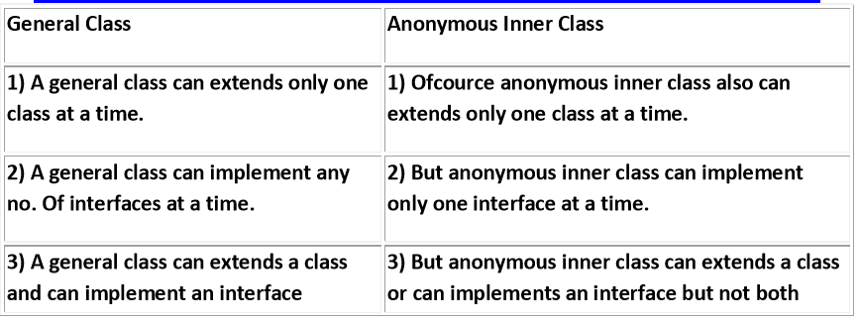
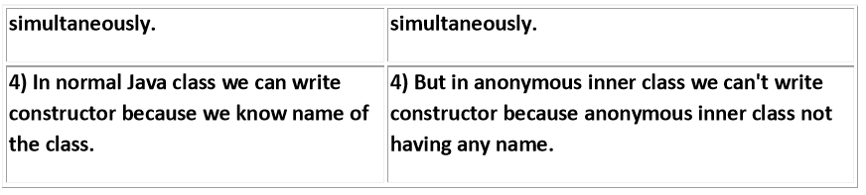
15

Slide 34
Explain the application areas of anonymous inner classes ?
anonymous inner classes are best suitable to define call back functions in GUI components
import java.awt.*;
import java.awt.event.*;
public class AnonymousInnerClassDemo {
public static void main(String args[]) {
Frame f=new Frame();
f.addWindowListener(new WindowAdaptor(){
public void windowClosing(WindowEvent e) {
System.exit(0);
}
});
f.add(new Label("Anonymous Inner class Demo !!!"));
f.setSize(500,500);
f.setVisible(true);
}
}
16

Slide 35
Without Anonumous Inner class :
class GUI extends JFrame implements ActionListener {
JButton b1,b2,b3,b4;
-----------------
public void actionPerformed(ActionEvent e) {
if(e.getSource()==b1) {
//perform b1 specific functionality
}
else if(e.getSource==b2){
//perform b2 specific functionality
}
---------------------
}
----------------
}
16

Slide 36
With Anonumous Inner class :
class GUI extends JFrame {
JButton b1,b2,b3,b4 ;
--------------------
b1.addActionListener(new ActionListener() {
public void actionPerformed(ActionEvent e) {
//perform b1 specific functionality
}
});
b2.addActionListener(new ActionListener() {
public void actionPerformed(ActionEvent e) {
//perform b2 specific functionality
}
});
--------- }
17

Slide 37
Static nested classes:
17

Slide 38
• Sometimes we can declare inner classes with static modifier such type of inner classes are called static nested classes.
• In the case of normal or regular inner classes without existing outer class object there is no chance of existing inner class object. i.e., inner class object is always strongly associated with outer class object.
• But in the case of static nested class without existing outer class object there may be a chance of existing static nested class object. i.e., static nested class object is not strongly associated with outer class object.
Example:
class Test
{
static class Nested
{
public void methodOne()
{
System.out.println("nested class method");
}
}
public static void main(String[] args)
17

Slide 39
{
Test.Nested t=new Test.Nested();
t.methodOne();
}
}
• Inside static nested classes we can declare static members including main() method also. Hence it is possible to invoke static nested class directly from the command prompt.
Example:
class Test
{
static class Nested
{
public static void main(String[] args)
{
System.out.println("nested class main method");
}
}
public static void main(String[] args)
18

Slide 40
{
System.out.println("outer class main method");
}
}
Output:
E:\SCJP>javac Test.java
E:\SCJP>java Test
Outer class main method
E:\SCJP>java Test$Nested Nested
class main method
• From the normal inner class we can access both static and non static members of outer class but from static nested class we can access only static members of outer class.
Example:
class Test
{
int x=10;
static int y=20;
static class Nested
18

Slide 41
{
public void methodOne()
{
System.out.println(x);//C.E:non-static variable x
cannot be referenced from a static context
System.out.println(y);
}
}
}
18

Slide 42
Comparison between normal or regular class and static nested class ?
19

Slide 43
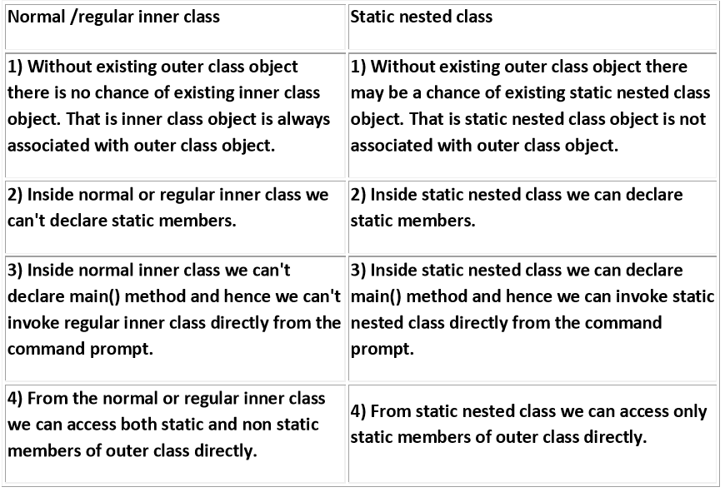
19

Slide 44
Various possible combinations of nested class & interfaces :
class inside a class :
• We can declare a class inside another class
• Without existing one type of object, if there is no chance of existing another type of object, then we should go for clas inside a class
class University {
class Department {
}
}
Without existing University object, there is no chance of existing Department object. i.e., Department object is always associated with University
2. interface inside a class :
We can declare interface inside a class
19

Slide 45
class X {
interface Y {
}
}
Inside class if we required multiple implements of an interface and these implementations of relevant to a perticular class, then we should declare interface inside a class.
class VehicleType {
interface Vehicle {
public int getNoOfWheels();
}
class Bus implements Vehicle {
public int getNoOfWheels() {
return 6;
}
}
class Auto implements Vehicle {
public int getNoOfWheels() {
return 3;
}
}
}
20

Slide 46
3. interface inside a interface :
We can declare an interface inside another interface.
interface Map {
interface Entry {
public Object getKey();
public Object getValue();
public Object getValue(Object new );
}
}
Nested interfaces are always public,static whether we are declaring or not. Hence we can implements inner inteface directly with out implementing outer interface.
interface Outer {
public void methodOne();
interface Inner {
public void methodTwo();
}
}
20

Slide 47
class Test implements Outer.Inner {
public void methodTwo() {
System.out.println("Inner interface method");
}
public static void main(String args[]) {
Test t=new Test();
t.methodTwo();
}
}
Whenever we are implementing Outer interface , it is not required to implement Inner interfaces.
class Test implements Outer {
public void methodOne() {
System.out.println("Outer interface method ");
}
public static void main(String args[]) {
Test t=new Test();
t.methodOne();
}
}
i.e., Both Outer and Inner interfaces we can implement independently.
21

Slide 48
In the above example Emaildetails functionality is required for EmailService and we are not using anyware else . Hence we can declare EmailDetails class inside EmailService interface .
We can also declare a class inside interface to provide default implementation for that interface.
Example :
interface Vehicle {
public int getNoOfWheels();
class DefaultVehicle implements Vehicle {
public int getNoOfWheels() {
return 3;
}
}
}
21

Slide 49
class Bus implements Vehicle {
public int getNoOfWheels() {
return 6;
}
}
class Test {
public static void main(String args[]) {
Bus b=new Bus();
System.out.println(b.getNoOfWheels());
Vehicle.DefaultVehicle d=new Vehicle.DefaultVehicle(); System.out.println(d.getNoOfWheels());
}
}
In the above example DefaultVehicle in the default implementation of Vehicle interface where as Bus customized implementation of Vehicle interface. The class which is declared inside interface is always static ,hence we can create object directly without having outer interface type object.
22

Slide 50
Conclusions :
1. We can declare anything inside any thing with respect to classes and interfaces.
2. Nesting interfaces are always public, static whether we are declaring or not.
3. class which is declared inside interface is always public,static whether we are declaring or not.
22

